Slide 1

AI-powered classification of the diabetic retinopathy severity
Thanh Thao Nguyen (nguyen53661@saskpolytech.ca)

Slide 2
Agenda
Introduction
Problem Statement
Objectives
Data Collection
Data Preprocessing & Analysis
Model Selection & Evaluation
Project Timeline
Conclusion
References

Slide 3
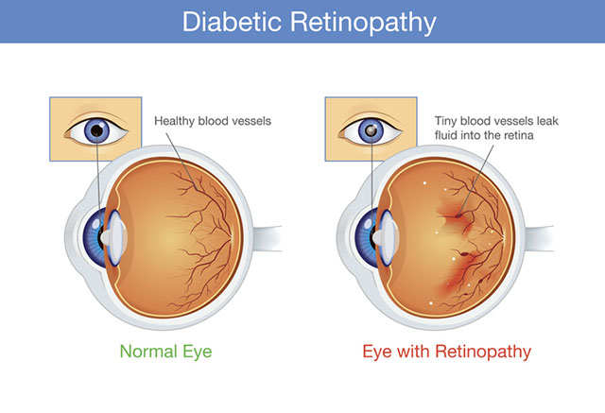
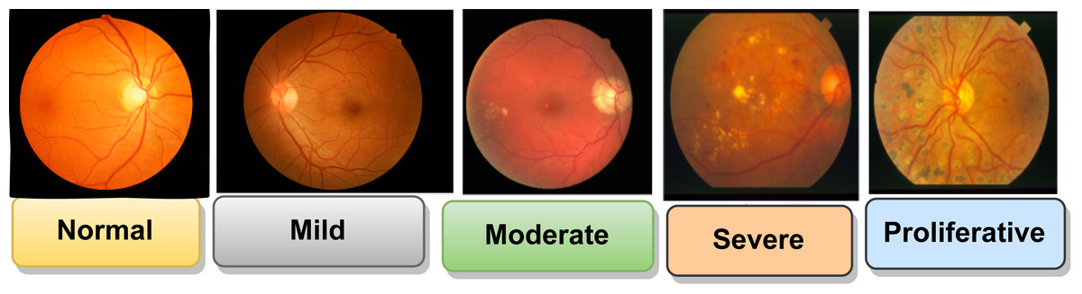
Introduction
Comparison between Normal Eye and Eye with Retinopathy
The severity of Diabetic Retinopathy ranges from Normal to Proliferative

Slide 4
Problem Statement
Cause
Diverse severity of disease
Different physical conditions of patients
Consequence
Incorrect classification in the early stages
Treatment is time-consuming and costly
Different disease manifestations of patients
Affect to patients’ physical and mental health

Slide 5
Objectives
Deep learning models classify Diabetic Retinopathy via retinal high-resolution images.
Efficiency: Automatic classification can screen twice as many patients as the traditional method.
Accuracy: It achieves 90% accuracy of classification at the early stage.
Real-world application: It reduces classification time, helps patients be treated early, and improves the quality of patients’ lives.
Reliability: It needs to be updated continuously.
Scalability: It can find out other eye diseases except Diabetic Retinopathy.

Slide 6
Data Collection
Diabetic Retinopathy 224x224 (2019 Data) with the link: https://www.kaggle.com/datasets/sovitrath/diabetic-retinopathy-224x224-2019-data
Diabetic Retinopathy Unziped with the link: https://www.kaggle.com/datasets/saipavansaketh/diabetic-retinopathy-unziped
eye_diseases_classification with the link: https://www.kaggle.com/datasets/gunavenkatdoddi/eye-diseases-classification

Slide 7
Data Preprocessing & Data Analysis
Data Preprocessing
Resize image for standardization
Identify and handle missing data
Reduce the quantity of photos which is unclear or have no labels
Data Analysis
Analyze a dataset's statistics, such as image resolution, class distribution
Identify potential issues, such as imbalanced classes

Slide 8
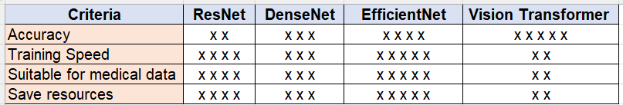

Model Selection & Evaluation
Deep Learning Model: EfficientNet
Libraries: Python, NumPy, Matplotlib, Scikit-learn.

Slide 9
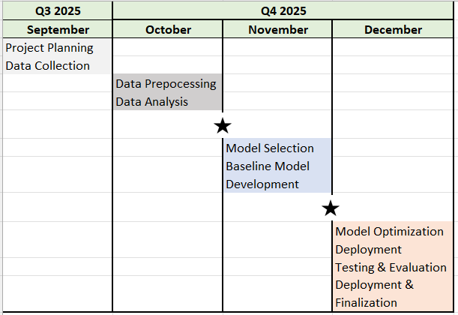
Project Timeline
3 and a half months, divided into 2 milestones:
Milestone 1: Baseline Model Development
Milestone 2:
Model Optimization Deployment

Slide 10
Conclusion
This project aims to develop a deep learning model EfficientNet using for Diabetic Retinopathy classification via retinal high-resolution images.
The steps, such as data preprocessing, model training, and evaluation, are implemented to create accurate and efficient classification.
The expected outcome is to reduce classification time, patients can have good treatment, and improve their life quality.

Slide 11
References (1/2)
Comparison between Normal Eye and Eye with Retinopathy. From Diabetic Retinopathy [Photograph], by Bobbi Nodell, 2020, (https://newsroom.uw.edu/news-releases/ai-technology-doesnt-reliably-detect-diabetic-eye-disease). 206.543.7129
The severity of Diabetic Retinopathy ranges from Normal to Proliferative. From Stages of DR [Photograph], by Prasanna Porwal, Samiksha Pachade, Ravi Kamble, Manesh Kokare, Girish Deshmukh, Vivek Sahasrabuddhe, Fabrice Meriaudeau, April 24, 2018, “Indian Diabetic Retinopathy Image Dataset (IDRiD)”, IEEE Dataport, https://dx.doi.org/10.21227/H25W98, (https://peerj.com/articles/cs-1947/). CC BY 4.0 DEED.

Slide 12
References (2/2)
Samia Akhtar, Shabib Aftab, Oualid Ali, Munir Ahmad, Muhammad Adnan Khan, Sagheer Abbas & Taher M. Ghazal. (30 January 2025). A deep learning based model for diabetic retinopathy grading. Scientific Reports, volume 15, Article number: 3763 (2025). https://www.nature.com/articles/s41598-025-87171-9.
Zijian Wang, Yi Wang, Chun Ma, Xuan Bao & Ya Li. (10 August 2025). Diabetic retinopathy classification using a multi-attention residual refinement architecture. Scientific Reports, volume 15, Article number: 29266 (2025). https://www.nature.com/articles/s41598-025-15269-1

Slide 13
Thank you

